Slide 1
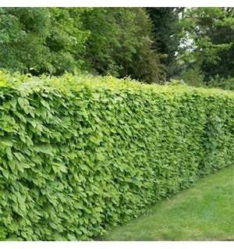

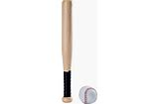
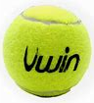

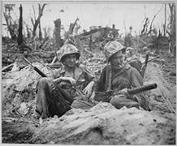
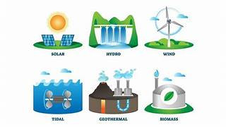



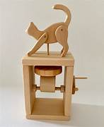



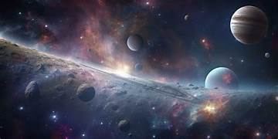
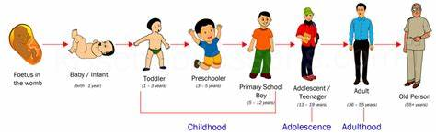

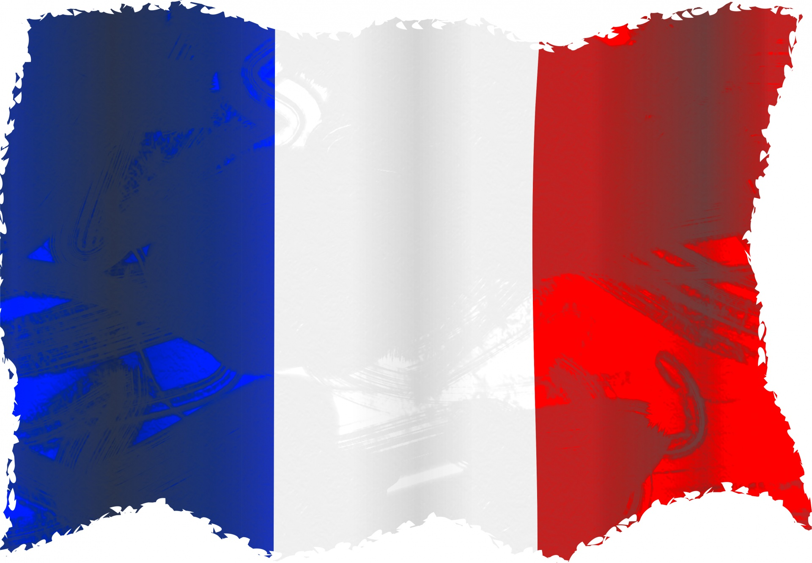

Music – Charanga
Ukulele (Summer 1)
Reflect, rewind, replay (Summer 2)
Hornbeam Class
Summer Term 2026
P.E
Summer 1 – Striking and fielding- Rounders
- Net & wall games - Tennis
Summer 2 – Athletics
- Sports leader training
History / Geography KAPOWto
What was the impact of WW2 on the people of Britain? (Summer 1)
Where does our energy come from?
(Summer 2)
PSHE- JIGSAW
Summer 1 – Relationships
Summer 2 – Changing Me
English
Herts for Learning
Inform – Explanation – The lost book adventure
Persuade – Advertising Campaign
Discuss – Reviews
Entertain – Narrative – Description of setting and character – Birdsong
Entertain – Poetry – Cloud Busting
Spelling – Spelling shed
Read Write Inc – catch up groups
Handwriting scheme - Nelson
Art/Design Technology- KAPOW
Art Summer 1 –
Drawing – Depth, Emotion and movement
DT Summer 2 –
Mechanisms – Automata toys
Drawing – Depth, Emotion and movement
DT- Cooking - Developing a recipe
Computing- Purple Mash
Summer 1 – Word Processing
Summer 2 – 3D modelling
- Microbit 5
R.E- UC and Local Agreed Syllabus
Summer 1 – GOSPEL UC – How do Christians decide how to live? What would Jesus do?
Summer 2 – How can following God
bring freedom and justice?
Science- KAPOW
Forces & Space – Unbalanced (Summer 1)
Animals – Human timeline & making connections (Summer 2)
Maths White Rose Maths Scheme
Ratio
Algebra
Shape
Position and direction
Statistics
Converting units
MFL- KAPOW- French
Summer 1 – French speaking world
Summer 2 – Planning a French holiday
Class Reader:
Finishing The Land of Roar
moving on to
Over the line by Tom Palmer

