Slide 1


Kensworth CE Academy
Welcome to Oak Class
Teachers:
Miss Yesinkas
Teaching support:
Mrs Rahman

Slide 2
Kensworth CE Academy
What do I do if my child is ill?
Please always let the office know. You can phone or email:
Tel: 01582 872336
Email: office@ken.dsamat.co.uk
You can let us know too but the office must always know.

Slide 3
Kensworth CE Academy
What do I do if someone else is picking up my child?
Please always let the office know. You can phone or email:
Tel: 01582 872336
Email: office@ken.dsamat.co.uk
You can let us know too but the office must always know.

Slide 4
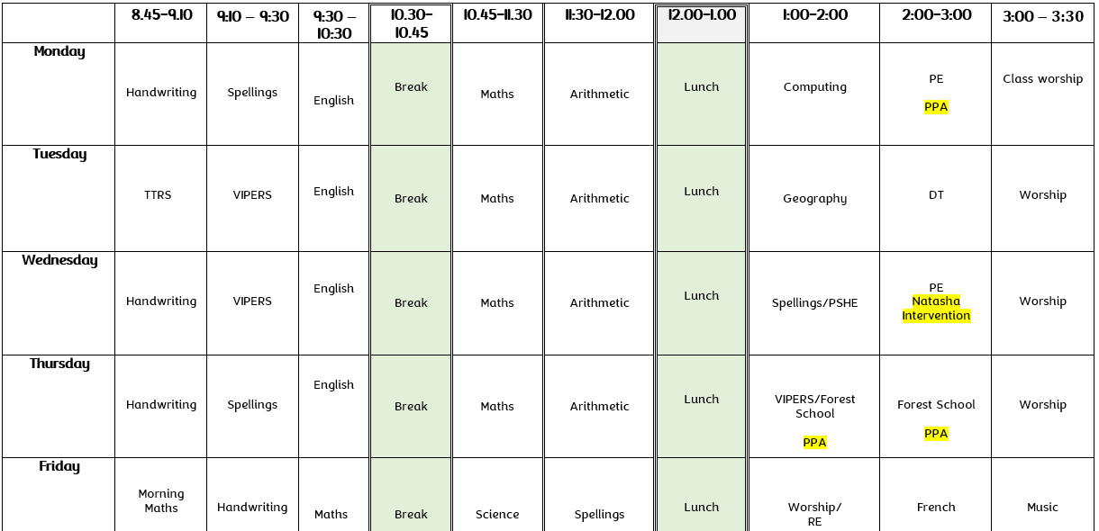

Slide 5
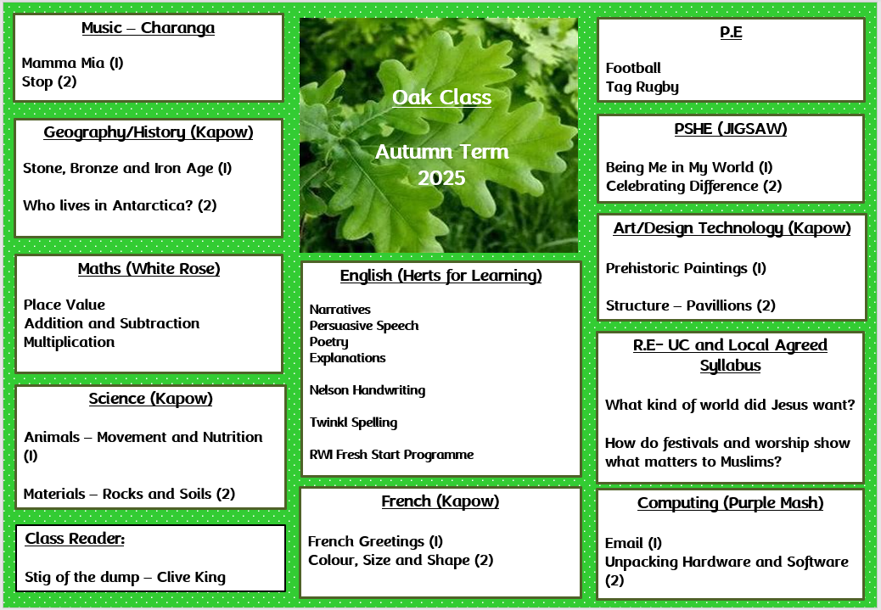

Slide 6
Kensworth CE Academy
PE & Forest School
This year our PE days are Monday and Wednesday.
Forest School – Thursday afternoons until Christmas.

Slide 7

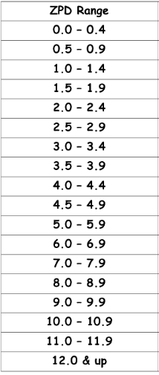

Kensworth CE Academy
Reading
Reading is extremely important in all aspects of life and should be enjoyed by all.
Previously, it was deemed that reading anything other than books was not really reading. This could not be further from the truth.
The DfE has decided to highlight the importance of both reading and being read to in the national curriculum and has stated that any means of text is now classed as reading and is highly valuable.
Here at Kensworth CE Academy we have invested in the renaissance accelerated reader programme to help track children’s reading abilities in greater depth.

Slide 8
Kensworth CE Academy
Reading
This year we are focusing on reading for pleasure. Our new reading records, introduced last year, contain all the Year 3 and 4 words that children need to be able to read and write before the end of the year group. These must be in school every day as the children will be reading at school and they contain important login information.
Please listen to your children read as often as possible and write in their reading records.
Even if your child reads on their own, please sign their reading record so we know they’ve read at home.

Slide 9

Kensworth CE Academy
Spellings
We have began using the Jane Considine spelling book programme for our teaching of spelling. This involves having a spelling test every 2 weeks in order to enable children to practice their spellings. Furthermore, the children will complete some spelling investigations to underpin their spelling knowledge and help them create links with focus phonemes.
This will support children in spotting patterns and reinforcing their phonics knowledge to help them decode words more fluently.

Slide 10

Times Tables
Times tables are an important part of our lives in multiple situations of everyday life.
Children need to understand the importance of times tables in order to maximise their use as a master skill. Reminding the children when we can use times tables to make life easier, further supports us in ensuring they are making the most of their knowledge and recalling these facts accurately in the quickest time possible. This will further support children in achieving highly in their upcoming SATs by improving their mathematical fluency.
Times Tables Rock Stars is a fun game-based math programme that takes all the worry out of learning times tables and has a proven track record of boosting children’s fluency and recall in multiplication and division.
Year 4 children in the Summer term will undertake a MTC Check, where children are fluently expected to know all tables up to the 12s.

Slide 11
Kensworth CE Academy
Home Learning
Homework will be set on a Friday beginning next week (26/09/2025).
Children will receive a paper copy of a Maths and English activity to complete which will be expected to be returned by the following Wednesday to be marked. This is to help embed and build on knowledge learnt in the classroom.
Children are expected to read a few pages of their book at home (either independently or with an adult) at least 3 times a week. This will support children with their reading, writing, spelling and fluency. Adults are expected to sign the children’s reading records stating the book title, pages read and whether they read aloud or silently.
Children are requested to complete 10-15 minutes of TTRS at home per day to help rapid recall of multiplication facts and improve their fluency of arithmetic (This will be monitored to check practice).

Slide 12

Class Dojo
Class Dojo will be used to make any communications with parents/carers. Please check the class chat regularly for updates in order to stay informed.
Please feel free to send in any questions or queries to myself. I will endeavor to respond to you at my earliest convenience.
Furthermore, if children wish to share their achievements outside of school with myself and their classmates please feel free to send in write ups, photos etc. and I will make sure they get shared.
I will also be adding dojo points to individuals or whole class for different achievements. Children will have the opportunity to earn rewards, House Points or prizes for numerous opportunities throughout the year.

Slide 13
Kensworth CE Academy
Behaviour for Learning
This year we are targeting behaviour for learning, both inside and outside of the classroom.
Our behaviour policy is built around three overarching principles:
Ready, Respectful and Safe and the children have decided what these principles mean to them in their own classroom.
Our Positive Behaviour Policy can be found on our website and draws from the work of Paul Dix.

Slide 14
Kensworth CE Academy
Behaviour for Learning
Linked to these principles we have the rights of the child, United Nations Convention on the Rights of the Child. We have chosen four of the articles that are key to our school.
Right to be safe
Right to be happy
Right to be included
Right to learn

Slide 15
Kensworth CE Academy
Website
Finally, our class page on the school’s website is the place to go to find out information about our class.
Oak Class - Years 3 and 4 | Kensworth CE Academy (kensworthacademy.co.uk)

Slide 16
Kensworth CE Academy
Any questions?
A copy of these slides will be emailed out to you and are available on our website under the Parents section.

