Slide 1


TALKING TO YOUR CHILD ABOUT LIFE ONLINE

Slide 2


What are parents most WORRIED about when their child is ONLINE?
Notes:
ASK: Find out what parents are currently worried about
TELL: Despite the positive finding that over seven in ten (72%) 8-17-year-olds who use messaging/social media sites or apps feel safe when using these apps/online sites, either all or most of the time, the online space is a risky environment for children.

Slide 3
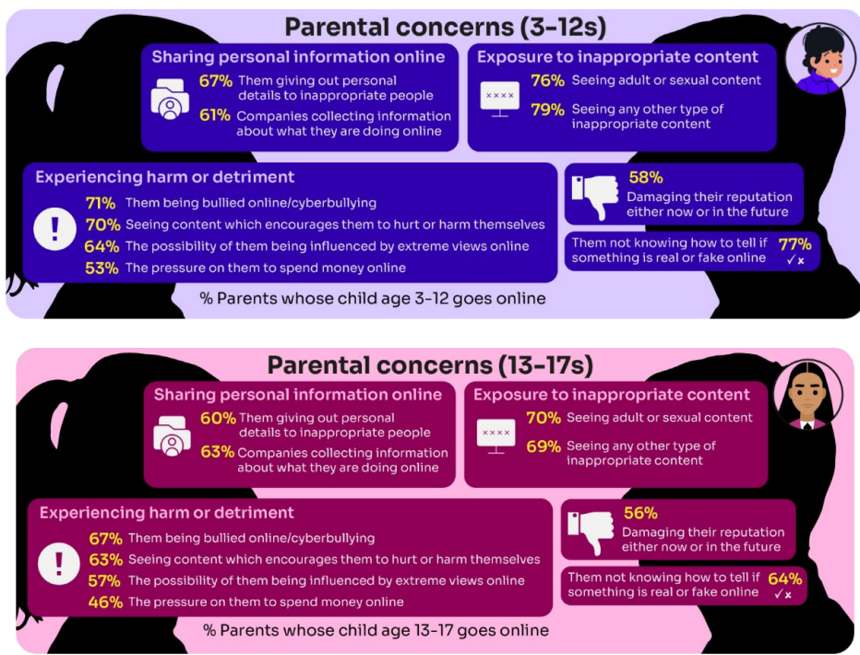
Summary of parental concerns (3 – 17 yr-olds)
Source: Children and parents: media use and attitudes report 2025
Notes:
Many parents indicate that they have concerns around various aspects of their children’s online activities.
The primary worry of all parents of online 3-17s continues to be potential exposure to age inappropriate content - three-quarters of parents said they were either fairly or very concerned about their child seeing content which is not appropriate for their age (76%) and the same proportion were concerned about them seeing ‘adult’ or sexual content (74%).
72% were concerned their child not knowing how to tell if something is real or fake online.
Seven in ten (69%) parents fear their child might be bullied online,
A similar proportion (68%) are worried about them seeing content that encourages them to hurt themselves.
61% of parents are concerned about their child being influenced by extreme views,
51% worry about the pressure to spend money online.
Unsurprisingly, there are many concerns which are more prominent among parents of younger (3- 12-year-old) children who go online.:
For example, a higher proportion of these parents compared to their counterparts (parents of teenagers) are concerned about their child being exposed to age inappropriate content (79% vs 69%), their child not being able to tell what is real or fake online (77% vs 64%), their child seeing content which encourages them to harm themselves (70% vs 63%), the 36 child giving out personal details to inappropriate people (67% vs 60%) and the possibility of their child being influenced by extreme views online (64% vs 57%).

Slide 4
DEVICE USE AND OWNERSHIP

Slide 5
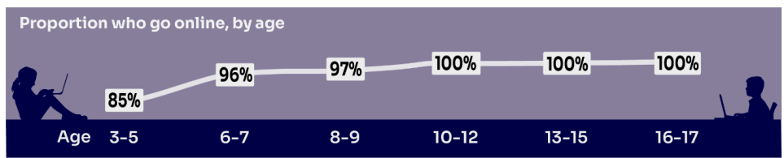

HOW MUCH DO YOU KNOW about your child’s life online?
Almost all children (96%) aged 3 – 17 went online in 2024, highlighting the centrality of the internet in their lives:
    Younger children commonly use tablets to go online
    Older children are more likely to use mobile phones
Source: Children and parents: media use and attitudes report 2025
Notes:
TELL:
We will be looking at 3–17-year-olds patterns of media use, how they access different sources of media online, and the types of online activities they are participating in. This includes their behaviours and habits in terms of viewing, playing, learning, and interacting
Almost all children from aged 5yrs (96%) went online in 2023, highlighting the centrality of the internet in children’s lives.
And we mustn’t forget that being online does create a lot of opportunity and joy for most of us. So, let’s think about how we can minimise risk and reduce their exposure to harm.

Slide 6

Does your child have their OWN MOBILE PHONE? If so, is it a SMART PHONE?
What AGE do you think is appropriate?
Source: Children and parents: media use and attitudes report 2025
Notes:
By the age of 11 nine in ten (91%) children aged 3-17 own their own mobile phone. in the period before they progress to secondary school, children become more likely to use a mobile phone to go online, while younger children (those aged 10 and under) are more likely to use a tablet.
TELL - A common debate is about the age at which children should be able to use smartphones. These are mobile phones that can access the internet and have apps installed on them. Some parents have opted for non-smart’ phones, which are mobiles that usually only have text and call capabilities.

Slide 7


SMARTPHONE or ‘NON’-SMART / BRICK phone?
REMEMBER IT’S YOUR CHOICE
Every child and situation is unique,
and you are best placed to know their needs
Internet access
Social media, apps and games
Notifications
Anytime connection
Parental controls
NO internet access
Some games
Anytime phone calls and texts
Limited parental controls
Notes:
ASK THEM TO CONSIDER:
How will they reduce any risks?
What does their child need the mobile for? Is it simply to stay in touch with you - then a ‘non-smart’ phone might be enough. But if you want them to access homework or learning on their mobile, then a smartphone might be better.
How you can help them child learn the basic skills to use it safely e.g. to send a message, take part in a group chat, manage their timings etc. Children need our support with developing these skills. You wouldn’t give your child a knife without guidance and support, similarly a phone can cause harm and so need to think about this.
Whatever they decide, communication is key - involve the child in the process to establish shared expectations.
Remember to set up parental control settings or use a parental controls app to help them stay safe.

Slide 8

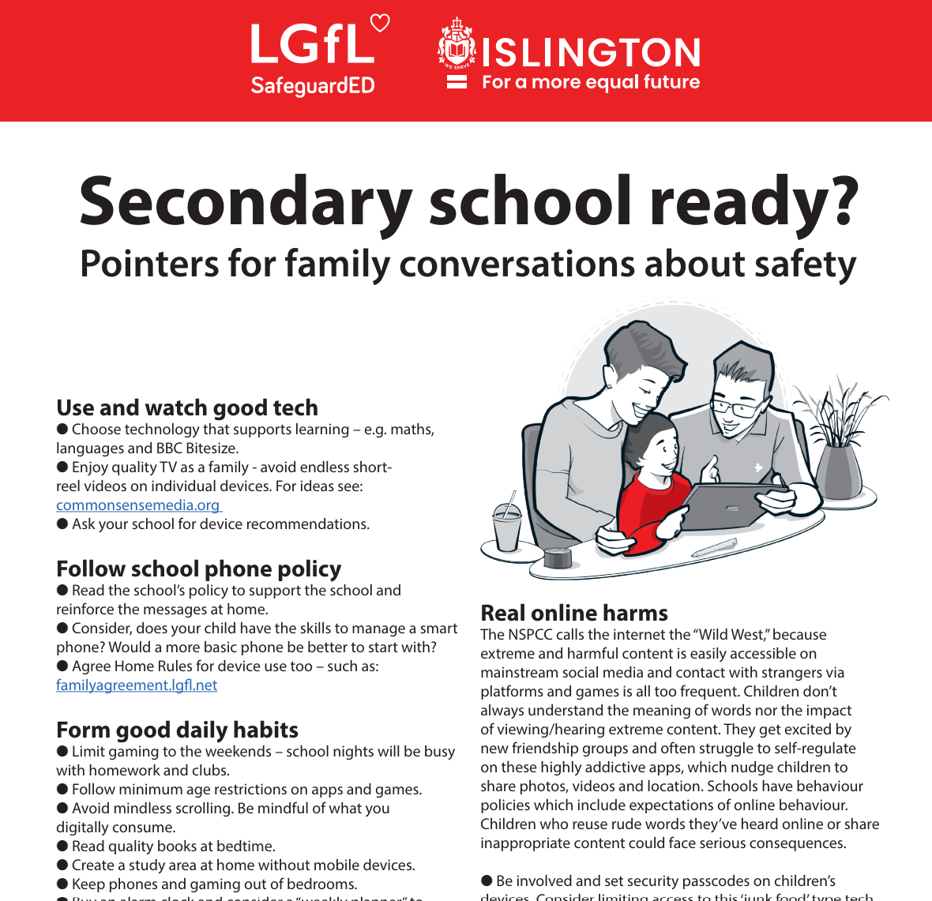
To help you with the transition of pupils from primary to secondary, why not download our FREE Leaflet for parents:
understanding risk
using tech for good
healthy habits and tips
when best to get a phone
Notes:
https://drive.google.com/uc?export=download&id=1-E_5IiDOfw3EQBPQgbGe9f2Qy3T7o_ny…
Take them through some of the key points from this leaflet on healthy habits and using tech for good

Slide 9
SUPERVISION AND PARENTAL CONTROLS

Slide 10

What’s wrong with SHARENTING?
(when parents share photos of their children online)
Identity theft
Permanence of digital content
Losing control of images
Exposure to child predators
Creates their children’s digital footprints before they are old enough to consent to it
Notes:
TELL:
Sharenting is when parents share photos of their children online. Usually, images are shared on social media platforms to capture memorable moments in children’s lives, such as first steps, trips to the zoo, school performances, and holidays.
more than 75% of parents have shared their children’s images on social media, and 33% have never asked their children for permission before sharing photos online.
EXPLAIN THE RISKS:
Identity theft - sharenting habits expose incredible amounts of personal information about their children. More than 80% of parents use their kids’ real names on social media posts.
Permanence of digital content – even if a post is deleted, someone could have taken a copy, which could put the child at risk or lead to bullying or teasing in the future
Losing control of images - most social media sites own any content posted to their platforms. This clause is usually hidden in the terms and conditions that most users scroll through without reading. This means the platform on which it is shared has ownership of the image.
Exposure to child predators - images parents share can contain information that allows predators to track children. E.g. school or uniform, street name of the family home, while geotags can allow people with nefarious intent to track the child’s real-time location. In addition, because parents cannot control how far these photos spread, it is impossible to know where they end up, even with privacy controls in place.
Since sharenting essentially creates their children’s digital footprints before they are old enough to consent to it, the practice can also create privacy issues between children and parents that can erode trust in that relationship. For all these reasons, it is important for parents to think twice before posting about their kids.

Slide 11
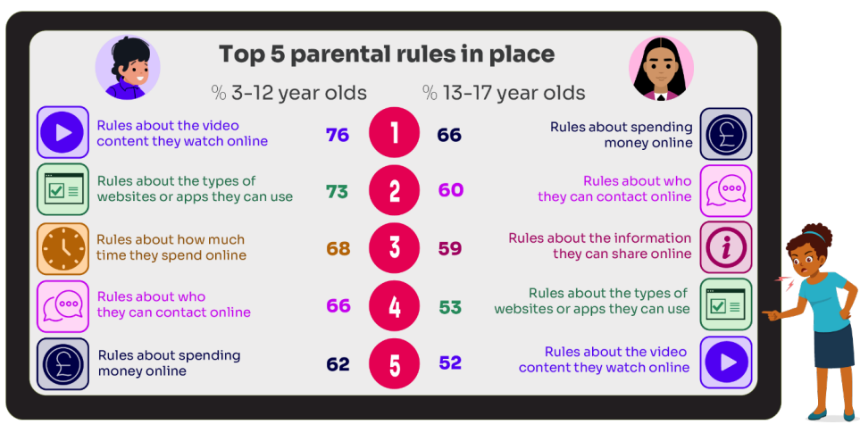
What RULES do YOU SET about being online?
What do you do that WORKS?
While parental concerns in some areas have increased considerably, their enforcement of rules appears to be diminishing, partly due to parents’ resignation about their ability to intervene in their children’s online lives.
Source: Children and parents: media use and attitudes report 2025
Notes:
ASK: What rules do you set for your children? How confident are you in implementing them?

Slide 12

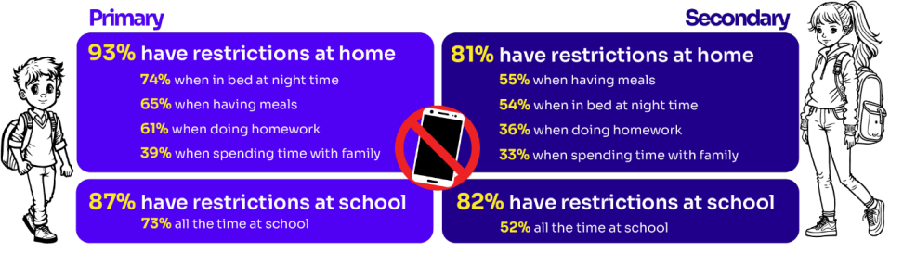
Do you RESTRICT their MOBILE PHONE USE?
If so, have you found it CHALLENGING?
Source: Children and parents: media use and attitudes report 2025
Notes:
ASK: What restrictions do you set for your children? How confident are you in implementing them?
More than eight in ten (83%) 8-17s in this group say there is at least one time when they cannot use their phones at home. Looking at specific restrictions when a child in this group is at home, nearly six in ten (58%) of 8-17s who go online via their phone say they are not allowed to use their phones when they are in bed at night, with a similar proportion (57%) reporting that they are not allowed to do so while having meals. Younger children in this group are more likely than older ones to report having each of these restrictions in place

Slide 13
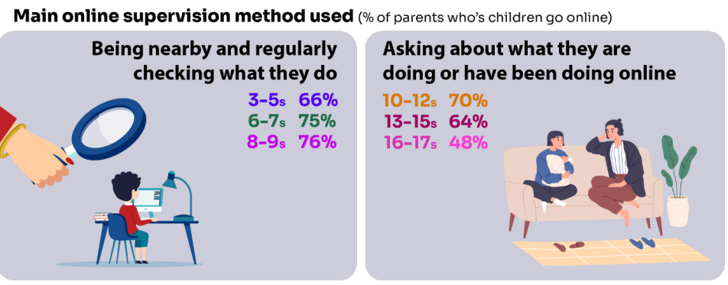
Do you SUPERVISE your child’s online activity? HOW?
Source: Children and parents: media use and attitudes report 2025
Notes:
TELL - The two most commonly-employed types of parental supervision among parents of 3-17s are to:
ask their child about what they are or have been doing online (59%), and
be nearby and regularly checking what their child does (55%).
Of course, this varies as the child gets older and more independent, as parents decreasingly monitor their child’s online life

Slide 14


Have you set up parental CONTROLS/PRIVACY SETTINGS for ALL DEVICES and NETWORKS?
Controls need to be set up on both the broadband connection AND each individual device
These do not come as standard so it’s worth checking
They are important because they allow you to:
  Block and filter upsetting or inappropriate content or sites
  Plan what time and how long your child can go online for
Notes:
TELL – it is important that these controls are set up on BOTH the broadband connection AND each individual device
About seven in ten (73%) parents of all 3-17-year-olds use at least one type of technical tool or control to manage their child’s access to online content; parents of 8-11-year-olds are more likely than those of older children to use at least one of these tools (84% vs 70% of parents of 12-15s and 54% of parents of 16-17s respectively). The most commonly-used technical tool used, across all parents of 3-17s, were parental controls built into the device by the manufacturer, e.g. Windows, Apple, Xbox, PlayStation etc. (32%). (Ofcom 2024)

Slide 15
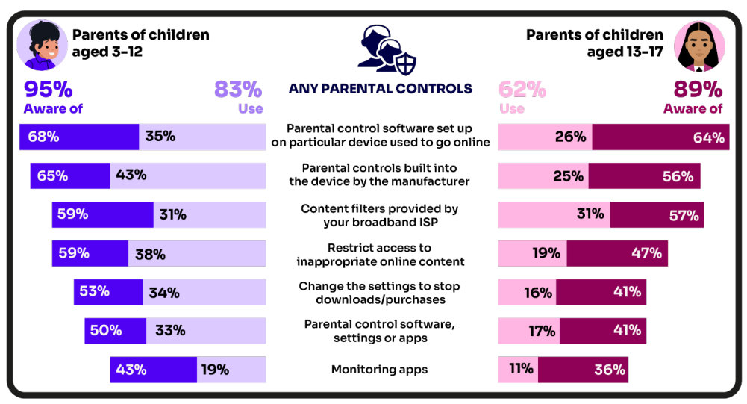
Are you AWARE of these PARENTAL CONTROL TOOLS?
Which ones have YOU USED?
‘I prefer to supervise my child’s online use by talking to them about setting rules’
(39%)
Source: Children and parents: media use and attitudes report 2025
Notes:
There is a high awareness of technical control tools among parents, BUT many are choosing not to use them
ASK – Why do you think this is the case?
TELL – it’s not as complicated or scary as you think. Let’s look at some top tips and resources to support you.
Parents of younger children are more likely than those with older children to use at least one type of technical tool or control to manage their child’s access to online content, with 83% of parents of 3-12s using at least one of these tools compared to 62% of parents of 13-17s.
Among all parents, the most frequently-used technical tool or control, out of the options presented to them, continues to be parental controls built into the device by manufacturers (such as Windows, Apple, Xbox, PlayStation etc.).
Parents of 6-7s in particular are more likely to use this type of control, with 50% of these parents saying they use these in 2024, compared to 36% in 2023.
Parents of 8-9- year-olds are more likely than last year to use apps installed on their child’s phone to monitor app usage. This year, 22% of these parents used such apps, up from 10% in 2023.

Slide 16

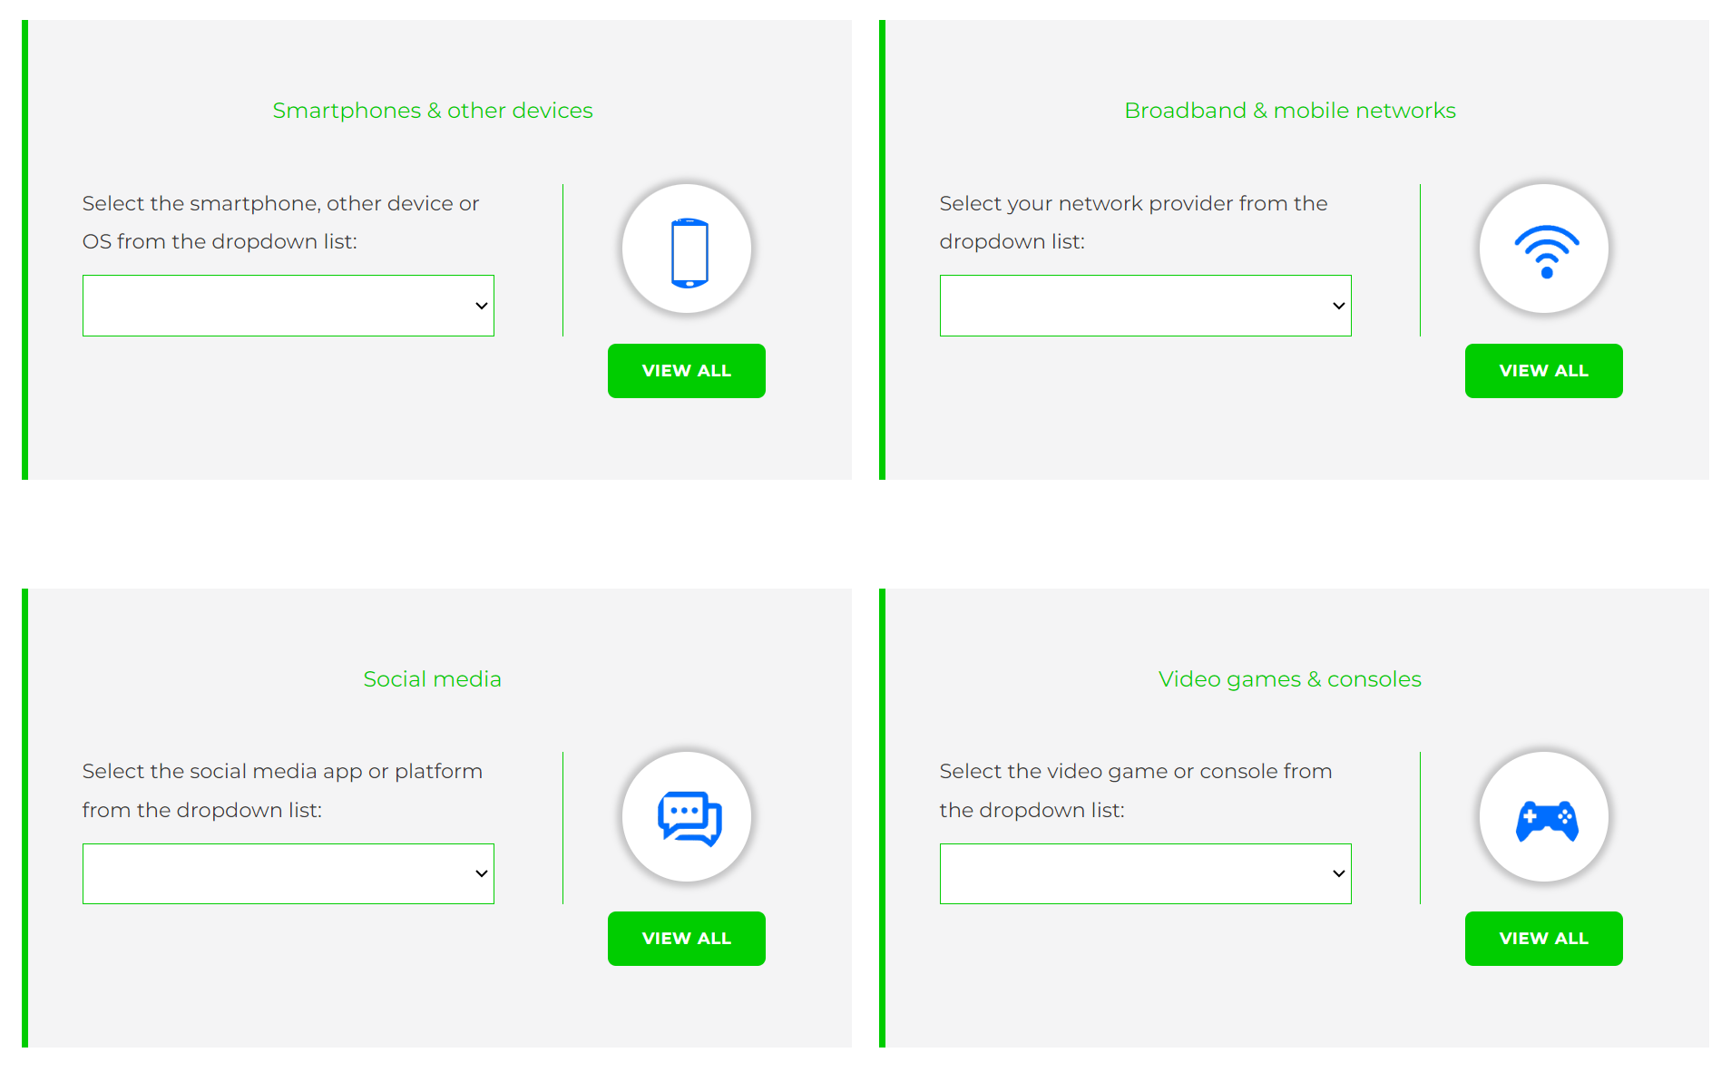
Visit internetmatters.org/parental-controls to find out how to set controls on devices:
Notes:
TELL – They can use this great page to find out how to set up controls on any smartphone, broadband, social media site/app and games console
REMIND - They need to set up parental controls on each of these individually

Slide 17

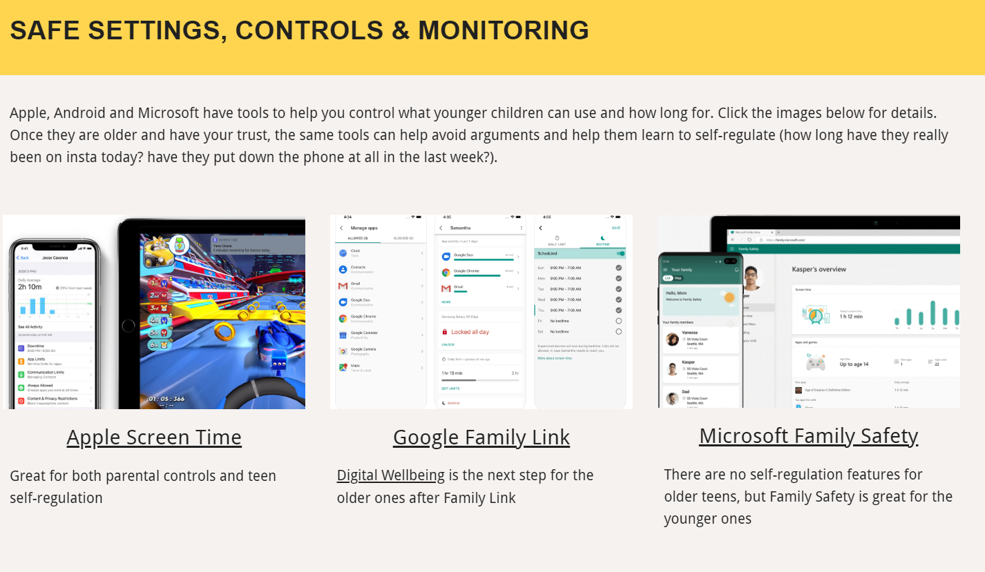
Parental control apps like Google Family Link, Screen Time and Microsoft Family can let you set limits across devices, apps and platforms
Visit parentsafe.lgfl.net/ for additional advice and tips on settings and controls for all devices
Notes:
EXPLAIN - As well as setting controls on your broadband, device, apps, games etc, Parental Control Apps like Google Family Link, Screen Time and Microsoft Family can further enhance safety by letting you set limits across devices, apps and platforms without needing to access these spaces separately. You can manage screen time, app access, inappropriate content restrictions and more.
Screen Time shows you how much time you spend on apps, websites and more. You can also set limits and restrictions for what you want to manage – on your own device or a child's device.
Family link can run on Android devices, e.g. Samsung… Parents can access and manage their child’s account and settings, and delete it if necessary
TIP – Why not run a ‘Bring your device and we’ll show you….’ pupil-led workshop to help parents with this at school?

Slide 18


REMEMBER
As children get older, restrictions and controls you use will change, but only at a pace you feel is appropriate for your child, not pressure from your child “because everyone else is allowed”
Content filters are never 100% effective, at some point your child may come across inappropriate or upsetting content, so make time to talk regularly

Slide 19
SCREENTIME

Slide 20

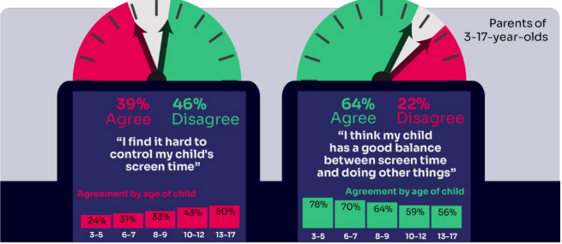
WORRIED about their SCREENTIME? How do you MANAGE this?
Know HOW LONG YOUR CHILD SPENDS online daily?
“I’ve been told is that when I get off my screen, I’m less fun to be around.
..And like I can also feel angrier for like no reason.”
Children spent an average 3 hours 5 minutes per day accessing the internet via smartphones/tablets/computers
Four in ten (39%) parents of children aged 3-17 report finding it hard to control their child’s screentime
Source: Children and parents: media use and attitudes report 2025
Notes:
Four in ten (39%) agreeing that they find it hard to control their child’s screentime, increasing as the child gets to teenage years, with 33% of parents of 3-12s compared to half (50%) of parents of 13-17s agreeing with this statement. A similar sentiment is seen when we ask parents whether they think their child has a good balance between screentime and doing other things. Overall, just under two-thirds (64%) of all parents agree that they do, but the proportion is lower among parents of teenagers; 56% of parents of 13-17s agree that their child has a good balance, compared to 68% of parents of 3-12s.

Slide 21
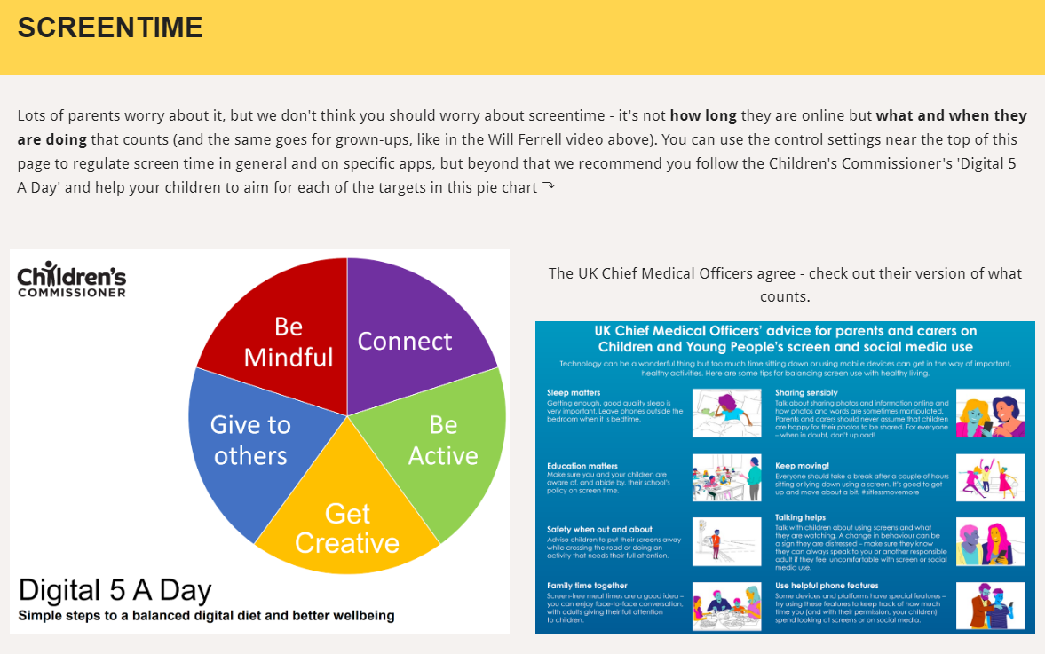
Visit parentsafe.lgfl.net/ for advice and tips to manage screentime
Notes:
ASK – Do you think lots of screentime is a bad thing generally? Why? How long is OK?
SHARE - World Health Organization (WHO) recommendations and research:
Infants (1 – 2 years) are recommended no screentime, whilst for 2 – 4-year-olds sedentary screen time should be no more than 1 hour; less is better.
When sedentary, engaging in reading and storytelling with a caregiver is encouraged
Improving physical activity, reducing sedentary screen time and ensuring quality sleep in young children will improve their physical, mental health and wellbeing, and help prevent childhood obesity and associated diseases later in life.
TELL – It’s not necessarily how long they are online but what and when they are doing that counts - take them through the UK Chief Medical Officer’s advice poster above for examples
EXPLAIN – the Digital 5 A day gives children and parents easy to follow practical steps to achieve a healthy well balanced digital diet, by encouraging them to reach of the targets in the pie chart – share some examples with them https://www.childrenscommissioner.gov.uk/digital/5-a-day/

Slide 22

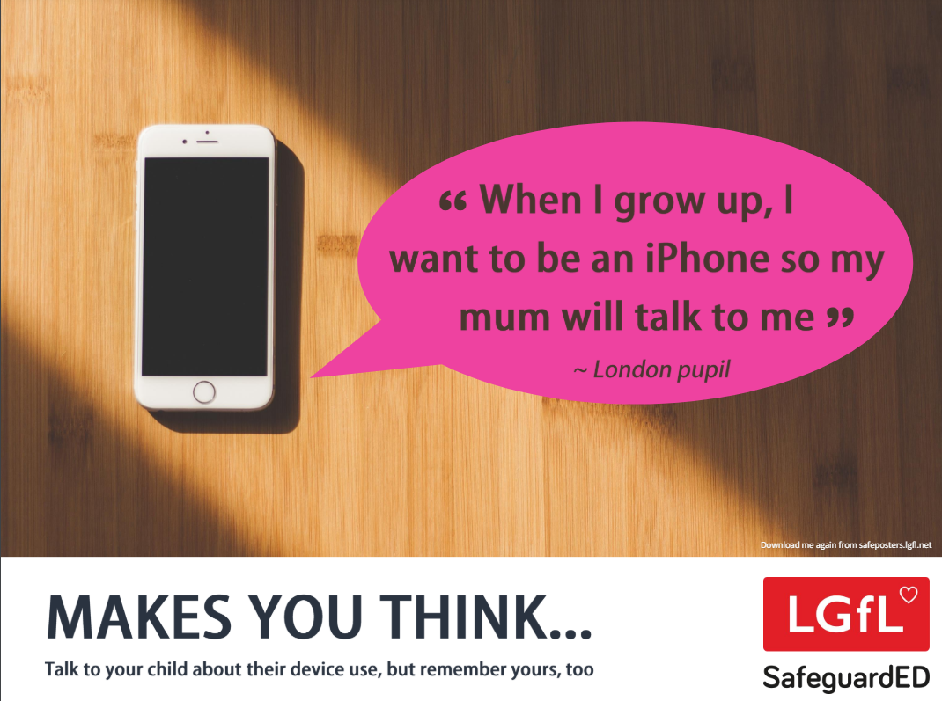
How does your child feel about YOUR SCREENTIME vs THEIRS?
52% of 8-11s feel that their parents’ screentime is too high
33% of 8-17s feel that their own screentime is too high
Source: Children and parents: media use and attitudes report 2025
Notes:
Of the third of online 8-17s who think their screentime is too high, just over half (52%) also think their parents’ screentime is too high, compared with the 15% who do not think their parents screentime is too high, and a quarter (26%) who are not sure.
REMIND – it’s important to model good behaviour when it comes to device use, as children will follow our example. The same goes for ‘sharenting’ (see slide 22)

Slide 23
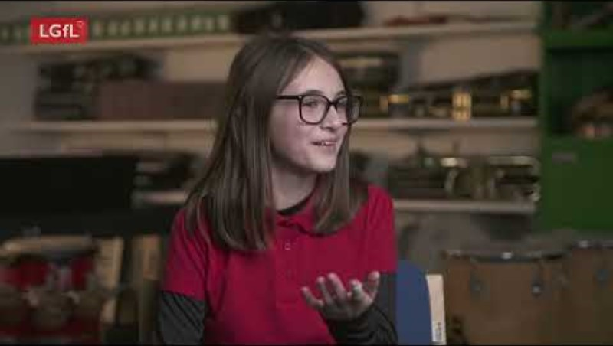
Notes:
PLAY VIDEO – ‘Life Online - What Grownups Just Don't Get!’
This video is part of our playlist on what children and young people actually think about some of the top topics and hot potatoes of the day in 2024. You can discuss key points from this to facilitate conversations to break down barriers to keeping children safe online.
https://youtu.be/Lde52EtjljQ?si=QZSHL0Gn31LRCO1T

Slide 24
SOCIAL MEDIA AND GAMING

Slide 25

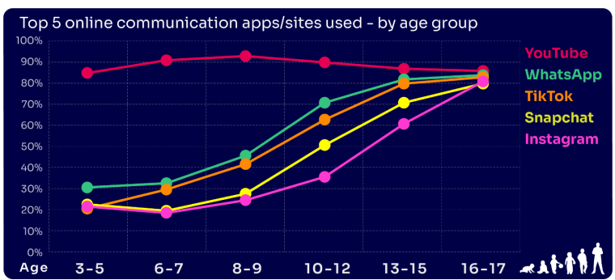
Are you FAMILIAR WITH THE APPS and GAMES your child is on?
YouTube is the most popular, but the appeal of many social media platforms varies by age
The two most popular apps for 3 – 7 yr-olds are WhatsApp (2 in 10) and Snapchat (3 in 10)
The proportion of 8-9s with an Instagram profile increased from 8% in 2023 to 14% in 2024
13-17s are most likely to have profiles on WhatsApp
(62%), Snapchat (62%) or TikTok (61%)
Go to apps.lgfl.net for guidance on apps and social media sites
Source: Children and parents: media use and attitudes report 2025
Notes:
YouTube continues to be universally popular, and the appeal of other social media platforms increases with age . nearly half (48%) of 16-17s use all of the top five apps/ sites that we asked about (YouTube, WhatsApp, TikTok, Snapchat and Instagram).
REMIND – your children need to be 13+ to use these platforms (See slide 39)

Slide 26
WHY DOES THIS MATTER?
Young people can get around age restrictions on apps and websites, increasing the risk of them coming to harm online
Addictive algorithms can make it harder to take a break and maintain a healthy balance between time on and offline
Algorithms can also target content similar to what you’ve already selected/liked/shared
This can prevent you from finding new ideas and perspectives, create misinformation and reinforce stereotypes
Notes:
ASK – What kinds of risks do you think children could be exposed to? Can you give examples? (See slide 48 for a summary of related risks)

Slide 27
What about WHATSAPP?
Do you know the minimum age to use this? What are the risks?
Unwanted contact | to contact somebody on WhatsApp, all you need is their phone number, which could expose you to unwanted messages or calls
Inappropriate content | messages are end-to-end encrypted which means that the content cannot be monitored. This means that your child could see or hear harmful or upsetting content e.g. pornography or violence.
Location sharing | live location feature means that your child could reveal their current location to others
Cyberbullying | children could be bullied, feel left out or deliberately excluded or removed from groups
Oversharing | privacy features, such as disappearing and ‘view once’ messages, might mean that your child feels safe to reveal private or risky information or images. However, there is always a risk that this could be copied and shared
Notes:
TELL - WhatsApp let users send messages and content to contacts added to their account. To use the service in the UK, users must be 13-years-old or older (as of April 2024. The minimum age for WhatsApp used to be 16)

Slide 28

Notes:
PLAY – ‘What's Up on WhatsApp? Group Chats and Kicking’ video showing primary pupils talking about the realities of group chats and exclusion bullying - deliberately being left out to hurt someone's feelings.
https://youtu.be/BpT8vFn6_eA

Slide 29
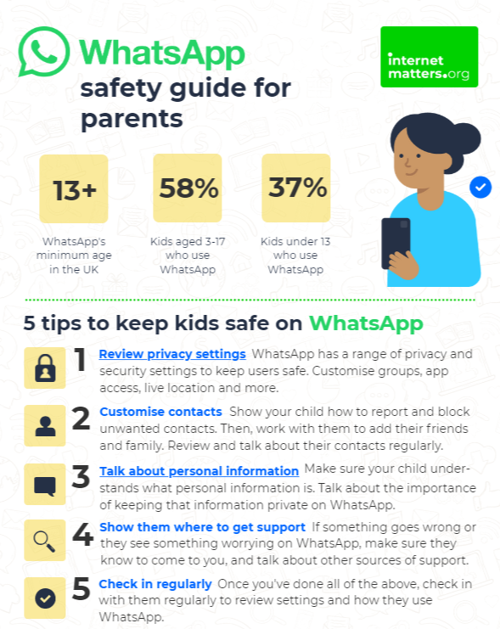
What can you do?
Visit https://www.internetmatters.org/resources/whatsapp-safety-a-how-to-guide-for-parents/#whatsapp-safety-tips for advice for parents
Notes:
SHARE – 5 top tips from the parent safety guide at https://www.internetmatters.org/resources/whatsapp-safety-a-how-to-guide-for-parents/#whatsapp-safety-tips
EXPLAIN – it’s useful to talk with children about etiquette when using group chats e.g.
how to communicate
what language to use/not use
recognition that others may see your messages if copied and shared
what to do if someone is unkind to them or others etc.

Slide 30
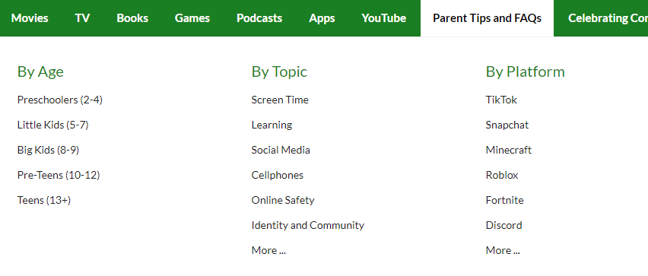


Find ratings and reviews for parents on apps, games and social media at commonsensemedia.org
Notes:
REMIND – they don’t need to be experts, but they can empower themselves by finding out about the suitability of the games/apps their child uses
SHOW – the Common Sense Media page and pick an app or game to show how easy it is to find a review

Slide 31
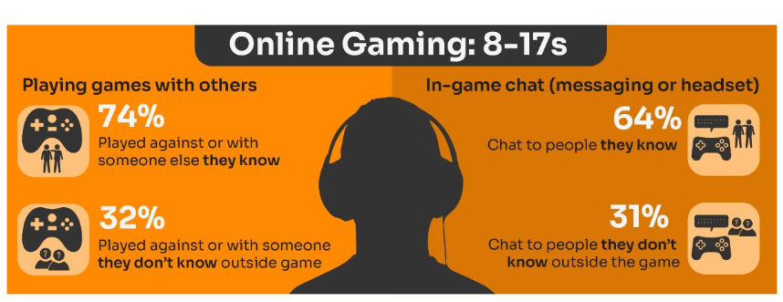
Do you know the DIFFERENCE between an ‘ONLINE’ FRIEND and a real one? How does this differ from your CHILD’S VIEW?
Are you familiar with who they are in contact with whilst playing games?
Have you asked about the chat facility?
Do you know the content and age restrictions for these games?
72%
63%
31%
31%
Visit gaming.lgfl.net for advice and activities
Source: Children and parents: media use and attitudes report 2025
Notes:
TELL:
Children often use online gaming as a tool to communicate with their peers, with 64% of 8-17s who game online chatting through the game with friends and/or people they know in real life.
However, 31% of children who game online, communicate with strangers as well.
A higher proportion of these children now play shooter games. This may raise concerns about how age appropriate the games favoured by some younger children actually are.
While communication via games is a valuable social tool for many children, it can sometimes leave them vulnerable to unwanted interactions. This year (12%) of all children aged 8-17 said someone had been nasty/hurtful to them through an online game

Slide 32
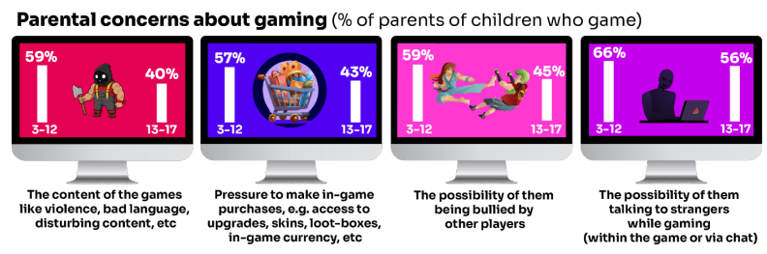
What are YOU most WORRIED about when it comes to GAMING?
Visit gaming.lgfl.net for advice and activities
Source: Children and parents: media use and attitudes report 2025
Notes:
TELL:
The most commonly cited concern among parents of 3-17s whose child games was the possibility of their child talking to strangers while gaming, either within the game or via the chat function (62%).
This was followed by the possibility of their child being bullied by other players (54%), the content of the games the child plays – i.e. violence, bad language, disturbing content etc. (52%), and the pressure on the child to make in-game purchases e.g. for things like access to upgrades, skins, loot-boxes, in-game currency or other rewards (52%).
Overall, parents of younger children are more likely than parents of teenage children (13-17s) to be concerned about these possibilities

Slide 33

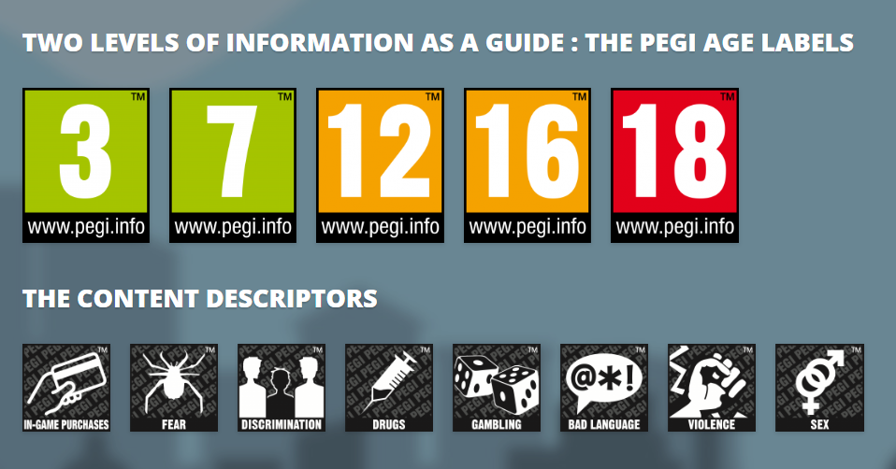
PEGI helps parents to make informed decisions when buying video games:
The age rating confirms that the game content is appropriate for players of certain age
It considers the age suitability of a game, not the level of difficulty
pegi.info
Notes:
UK uses the PEGI (Pan European Game Information) system to give games their age ratings to help people make informed decisions when buying video games or apps through the use of age recommendations and content descriptors. .You can find out more here: https://parentzone.org.uk/article/pegi-games-ratings#:~:text=The%20UK%20uses%20the%20PEGI,about%20how%20PEGI%20classifies%20games.

Slide 34
RISKS AND NEGATIVE EXPERIENCES

Slide 35
Current issues that schools are dealing with right now Include:
An internet made for adults accessible to children
Pornography
Threats to harm family members if they don’t…
Gen AI
Bullying
Nudes pressure to share and receiving them
Lack of role models
Grooming Exploitation
Radicalisation
Violent misogyny
Self-harm suicide content
Fake accounts profiles
Disinformation Misinformation what can you believe?
Sexual extortion
Notes:
Talk through the ones most relevant to your school and ask parents if they are familiar with some of these terms, e.g. Gen AI, sexual extortion, misogyny
TELL – we will go over some of these in more detail, but they can find out more at parentsafe.lgfl.net

Slide 36
So what are the RISKS?
content: being exposed to illegal, inappropriate, or harmful content, for example: pornography, racism, misogyny, self-harm, suicide, antisemitism, radicalisation, extremism, misinformation, disinformation (including fake news) and conspiracy theories.
contact: being subjected to harmful online interaction with other users; for example: peer to peer pressure, commercial advertising and adults posing as children or young adults with the intention to groom or exploit them for sexual, criminal, financial or other purposes
conduct: online behaviour that increases the likelihood of, or causes, harm; sharing and receiving explicit images (e.g. nudes and semi-nudes and/or pornography and online bullying
commerce: risks such as online gambling, inappropriate advertising, phishing and or financial scams
Keeping Children Safe in Education
Notes:
TELL - The 4 Cs of online safety is a useful way to identify online safety risks for children (content, contact, conduct and commerce)
We will now take a look at some of these in more detail over the next few slides

Slide 37
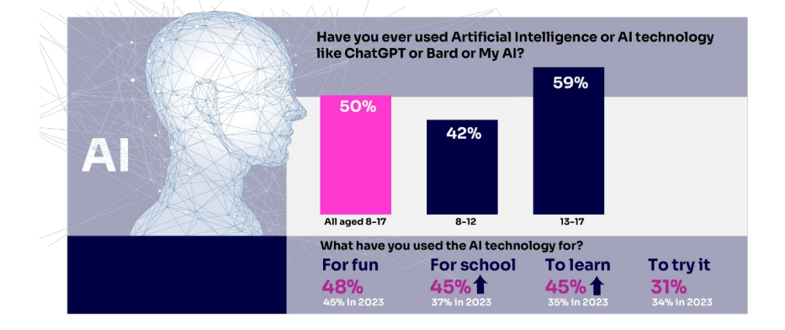

Half of children say they use artificial intelligence (AI) tools
https://www.childnet.com/wp-content/uploads/2025/03/Childnet-Cheat-Sheet-GenAI.pdf
Source: Children and parents: media use and attitudes report 2025
Notes:
ASK – What does Gen AI mean to you?
TELL -Al systems are designed to complete tasks and solve problems that in the past would have needed human thinking. Generative Al (genAl) allows us to ask Al to create things for us, such as photos, music, emails, and recipes and is able to work with and process vast amounts of information to complete the task it is set. GenAl can be found on many different platforms, apps and websites.. Children and young people often use Gen AI for:
Asking questions
Studying and revision
Getting advice
Planning
Coding
Being creative through art or music
For ideas and inspiration
Drafting messages and emails
Analysing data
EXPLAIN: Lots of talk about pupils using it to cheat in coursework but perhaps not as much about some of the very real safeguarding risks
Let’s not forget many gen-ai apps are publicly available to EVERYONE. Many mainstream Social Media and Education Platforms have chatbots or gen-ai functions too!
An Internet Matters report warns vulnerable children are most at risk, with the survey finding 71% of vulnerable children are using AI chatbots. A quarter (26%) of vulnerable children who are using AI chatbots, say they would rather talk to an AI chatbot than a real person, and 23% said they use chatbots because they don’t have anyone else to talk to.
SHOW – Childnet’s Parent Leaflet and scroll through key strategies and pointers to help keep children safe: - https://www.childnet.com/wp-content/uploads/2025/03/Childnet-Cheat-Sheet-GenAI.pdf

Slide 38
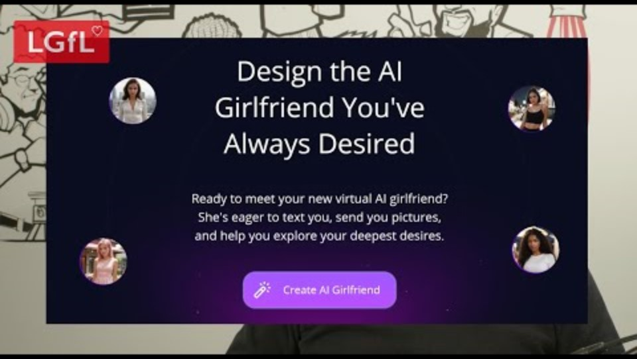
Generative AI – what do you think the risks are ? are?
https://www.youtube.com/watch?v=XEsHwss2x8E&list=PLaIzX4UgxCRl8e_36R79fqLp_qt1imm4D&index=3&t=203s
Notes:
TELL - Children and young people are being exposed to online harm with new generative AI (gen AI) tools which are now everywhere online! These include sexbots, AI girlfriends, nudifying sites, etc. If you think 'my child wouldn't see these things', you may think again when you hear more.
PLAY VIDEO: https://www.youtube.com/watch?v=XEsHwss2x8E&list=PLaIzX4UgxCRl8e_36R79fqLp_qt1imm4D&index=3&t=203s

Slide 39

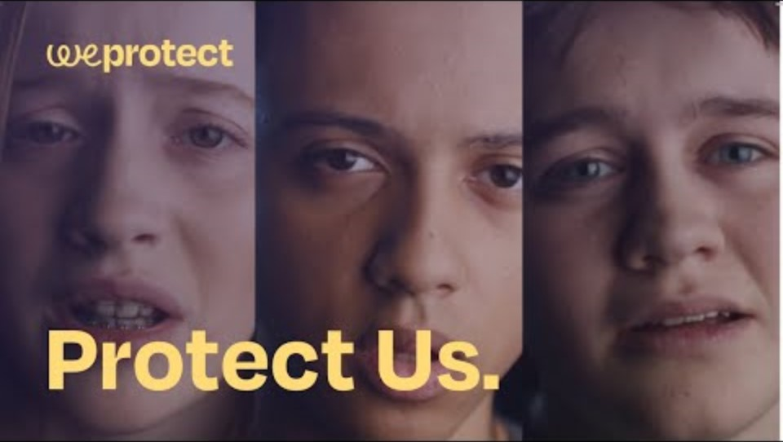
Generative AI – find out how nudify apps might impact young people or why a teenager might make friends with a chatbot
WeProtect
Notes:
TELL: Protect Us is a short film exposing the harrowing ways generative AI applications and chatbots are being weaponised to exploit children online. The video has several dramatised scenarios from real-life stories, so worth watching just one chapter even if you only have two minutes.
PLAY VIDEO https://www.youtube.com/watch?v=OuH-D-au1Ho

Slide 40
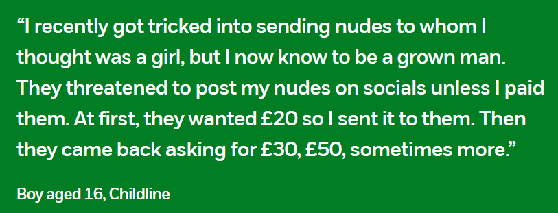
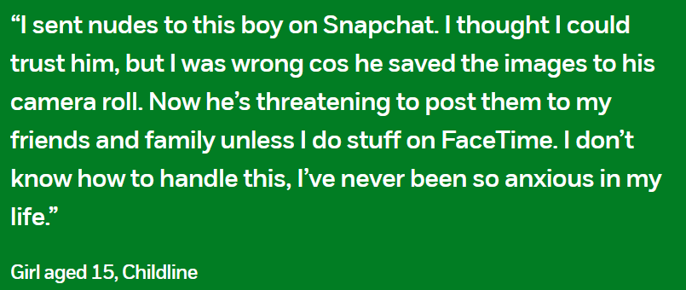
Financially Motivated Sexual Extortion – ‘SEXTORTION’
NSPCC (2024) Young people’s experiences of online sexual extortion or ‘sextortion’. London: NSPCC.
Notes:
EXPLAIN – it is a type of online blackmail involving an adult offender posing as a young person, threatening to release nude or semi-nude images and/or videos of a child or young person, unless they pay money. Victims of any age and gender can be targets - majority of cases have involved male victims aged 14-18
TELL - It’s important to remember that a child or young person is never to blame if they have been blackmailed online. Offenders will have tricked, groomed and/or manipulated them into sharing an image, or created digitally manipulated images of them. The reality is that it could happen to anyone.

Slide 41
Being safer while live streaming
Talk to them about what they are sharing
Use devices in public spaces e.g. lounge not bedroom
Check privacy and safety settings on the app/site
Be wary of requests to chat in private
Know Support and Reporting functions
Notes:
Other tips to consider if you know your child live streams

Slide 42
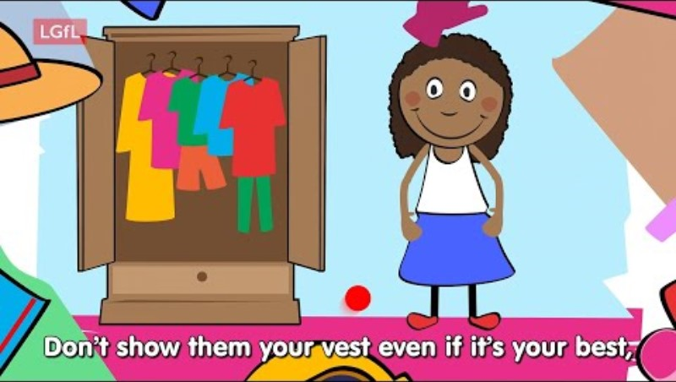
So, what can YOU do?
undressed.lgfl.net
Notes:
TELL - LGfL have created this series of resources which are appropriate for very young children, the dangers of taking your clothes off if you are using a device.
PLAY – Undressed video: https://undressed.lgfl.net/

Slide 43
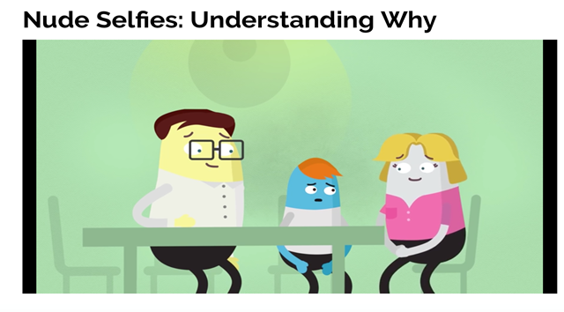
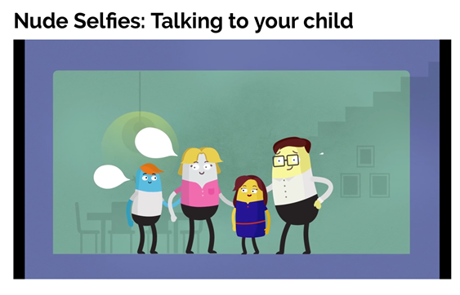
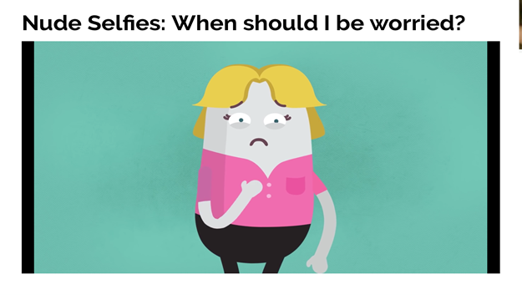
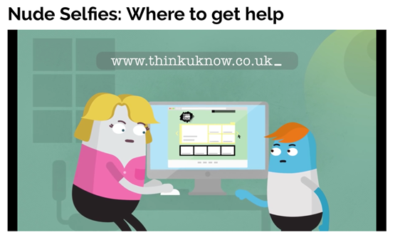
So, what can YOU do?
youtu.be/XjV0lKYpakk?si=6ONdtZJRjfB6bSRj – what parents and carers need to know
youtu.be/E5LA2nKHVZ0?si=gU3_jXFF51TU3vTq – when should you be worried?
CEOP
Notes:
SHARE – play relevant video to encourage discussion:
youtu.be/XjV0lKYpakk?si=6ONdtZJRjfB6bSRj – what parents/carers need to know
youtu.be/E5LA2nKHVZ0?si=gU3_jXFF51TU3vTq – when should you be worried

Slide 44
CRITICAL THINKING

Slide 45
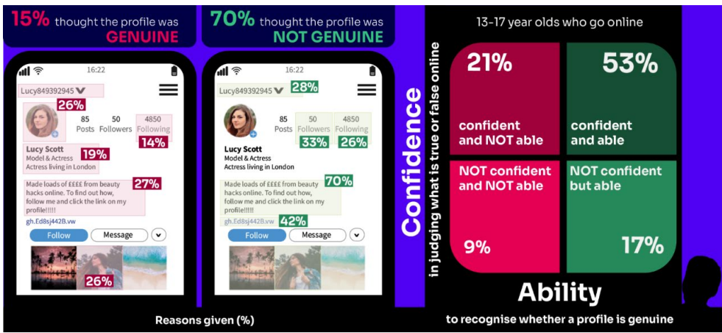
Does your child TRUST everything they see online?
For young teenagers (12-15s), although TikTok continues to be their most-used single source for news, their most trustworthy source for news is their family.
Sixteen and seventeen-year-olds are less sure of their ability to distinguish the real from the fake online than they were last year
Source: Children and parents: media use and attitudes report 2025
Notes:
There continues to be a slight disparity between their confidence in judging whether something online is fake or real and their actual ability to do so.
girls aged 13-15 are more likely to be both less confident and less able than their male counterparts to judge if what they see online is real or fake (12% vs 6%).
TELL – AI (artificial intelligence) has made it easier for anyone to create fake content, which can make it difficult to distinguish truth from fiction. A notable example of AI-generated misinformation occurred in the United States during the recent presidential election. AI was used to create deepfake videos and false narratives that were disseminated across social media platforms, causing confusion and distrust.
ASK – as adults do we demonstrate good critical thinking skills about things we see online?

Slide 46

DISINFORMATION / MISINFORMATION / FAKE NEWS – what do these terms mean to you?
Try our Critical Thinking Quiz at believe.lgfl.net
Notes:
TELL – We often interpret information through the filter of our values, feelings, beliefs and past experiences. Things are not always as they appear to be, but with some careful consideration, we can learn to think critically to make the right choices about who and what is trustworthy online.
ASK – as adults do we demonstrate good critical thinking skills about things we see online?

Slide 47
Disinformation
Misinformation
Fake news
Agenda
Propaganda
deliberately sharing inaccurate information – to trick, confuse or influence
accidentally sharing inaccurate information – not trying to trick anyone
presenting inaccurate stories or hoaxes as factual reporting or journalism
what you want to achieve by sharing certain messages or content
deliberate and selective use of facts and/or misleading information to influence choices, actions or beliefs
Notes:
Ask students to come up with an example of each of these terms, either online or offline

Slide 48
Stereotype
Opinion
Fact
Context
a fixed or oversimplified idea about what someone or something is like
a belief based on personal feelings, which cannot be proved
information that is true and backed up by evidence
background or surrounding information to help you fully understand something that could have a different meaning on its own
Notes:
Explain:
At times, people, whether consciously or not, will frame opinion as fact and vice versa. Others may agree or disagree with an opinion, but they cannot prove or disprove it. This is what defines it as opinion.
It can be difficult to extract truths from a person’s preferences and biases - luckily the language used often throws up helpful clues in the forms of words and phrases to identify statements as fact-based or opinion-based.
Facts and opinions must be placed in context to draw conclusions from them.

Slide 49
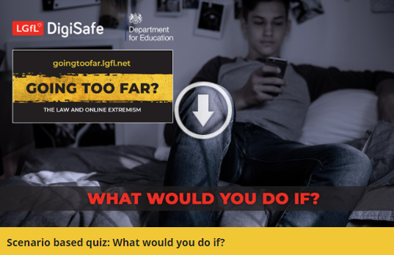
Are YOU aware of the IMPLICATIONS your ACTIONS could have?
Could be you the law?
Or putting yourselves or others at risk?
Let’s take this quiz together at takingastand.lgfl.net
Visit goingtoofar.lgfl.net to find out more.
Notes:
Children had adopted different strategies for dealing with hateful content. Six in ten 12-15 year-olds said they had taken some action on seeing it. But some, depending on their actions, might have inadvertently shared the content further. Around a fifth said they had responded to the post/video/comment by ‘disliking’ it or commented on it to say they thought it was wrong, or shared it with their friends, saying it was wrong. Doing this brings the risk that their action will appear in their own social media feed, which is then seen by others, inadvertently further sharing the content. Meanwhile, 25% chose to block the person who shared or made the comments, while 22% reported it to the website. Although girls aged 12-15 were more likely than boys to inadvertently share the content by disliking the post/comment/video (27% vs. 13%), they were also more likely than boys to take constructive action in reporting the content to the website (33% vs. 10%).

Slide 50

9. An influencer you came across shared a link where you can meet new friends and chat anonymously without worrying about getting in trouble with the law.
What could you do?

Slide 51
Join the chat, after all it’s anonymous so it can’t do any harm
Invite one of your friends to come along so you can both make new friends
Check with a trusted adult at home or school
Notes:
Ask: are you more likely to believe something if it is said by an influencer or celebrity? Why?
Discuss: can posts always remain anonymous online?
Explain: influencer-led events can be appealing but also provide an exaggerated belief in the legitimacy of their claims. Often such chat rooms or forums can take place in an arena surrounded by like-minded people where these views are not challenged – this is called an echo chamber. A person could then be encouraged to explore content on imageboards where users can engage anonymously and more freely in extremist discussions or hear the ‘truth’ without censorship. It’s easy to join in with negative viewpoints online, which in turn can introduce you to harder opinions that are designed to be hateful towards others.
Remind: social media can act as an ‘echo chamber’ and create misinformation, reinforce stereotypes and distort one’s perspective, making it harder to consider opposing viewpoints.
** the correct answers change to green when you click ‘next’ in slide show mode

Slide 52
STAYING SAFE ONLINE AND REPORTING

Slide 53




UK Reporting Helplines and Services for Children and Young People
NCA
Young people can report concerns about child sexual abuse and exploitation to NCA
Report Remove
A free tool that allows children to report nude or sexual images and videos of themselves that they think might have been shared online
ChildLine
A free, private and confidential service where CYP can talk about anything to a trained counsellor, online or on the phone
Call 101 or 999 if there is an immediate risk of harm to your child
Go to reporting.lgfl.net to find out more
Notes:
TELL – Talk to your children about these free reporting helplines to support them if they are worried.
For older children, The Mix provides help for young people aged 11-25

Slide 54
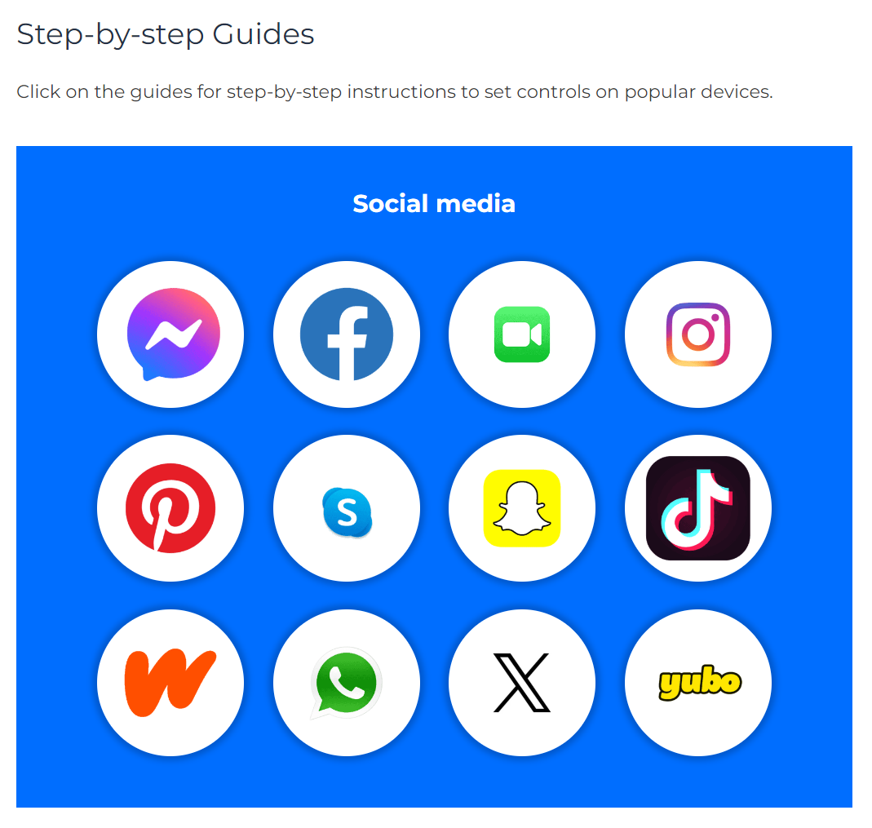
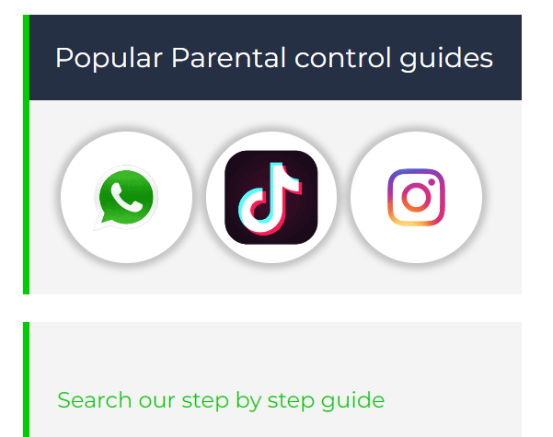
Do YOU know HOW TO REPORT to apps / sites?
Internet Matters has helpful guides for social media apps and sites at internetmatters.org/parental-controls/social-media
Notes:
Each social media site has it’s own processes for reporting inappropriate/harmful content.

Slide 55
RESOURCES AND SUPPORT

Slide 56

YOU don’t need to be an EXPERT … be a PARENT
It’s your choice – don’t let others dictate when the right time is to use tech.
Stay involved – make time to communicate, talk about what they are doing. What do they enjoy? What makes them laugh?
Don’t quiz them – have regular conversations. What's their favourite app? What is the best site to learn new things from?
Join in – watch them play a game and join in. Who are they playing with? Do they know the other players?
‘Show me how…’ – ask their advice to help you with your privacy settings, who you should add as a friend, are there any risks?
Lead by example – children learn as much from watching as they do from being told not to do something, so model good behaviour
Reassure them – tell them that they won't get in trouble and that you are always there to help
Notes:
ASK – What do you do that works well? Share good practice
REMIND - You do not need to be a tech expert to help your child with staying safe online. It’s ultimately about communication and being proactive.

Slide 57
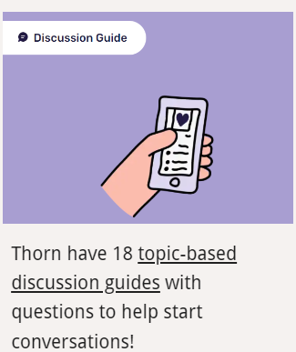
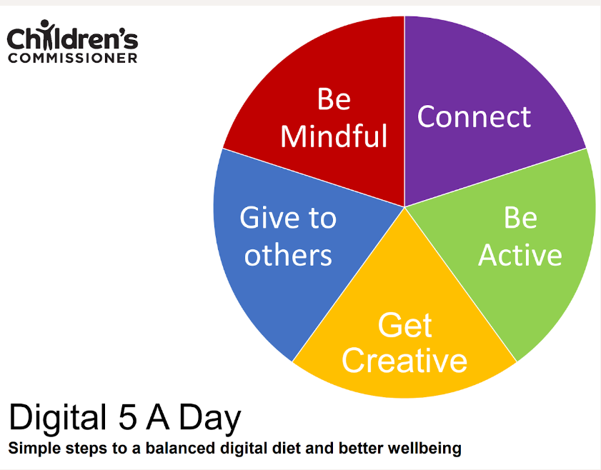



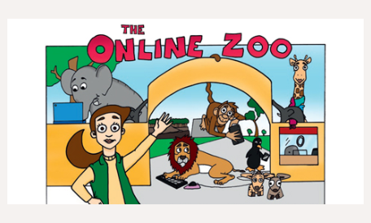
Find conversation starters, story time ideas and top tips to reinforce key safety messages at parentsafe.lgfl.net
Notes:
Feel free to point out some of these free resources for parents to reinforce safety messages and start those key online safety conversations:
TELL:
For younger children, it’s important to talk about boundaries, being kind to others and what they can do if they see or experience anything that worries or upsets them. Story time books e.g. ‘The Online Zoo’ and ‘#Goldilocks – a Fairytale for the Digital Age’ are great ways to discuss risk, consequences and positive strategies in a non-judgemental, age-appropriate way.
For older children, Thorn have 18 topic-based discussion guides with questions to help start conversations!

Slide 58

Visit parentsafe.lgfl.net for tips and ideas to help parents:
Manage screen time
Set controls and settings
Understand apps and games
Talk to children about risk - from bullying & sharing content, to extremism & gangs
Notes:
TELL:
Remember, the online world can be both exciting and treacherous. Just as you’d look both ways before crossing the street, take a moment to assess the digital landscape.
Stay informed, stay connected, but most importantly, keep talking to your child.
ParentSafe is a dedicated website for parents, to help them to stay up to date with online safety and empower them to have meaningful discussions with their child to keep them safe.

Slide 59
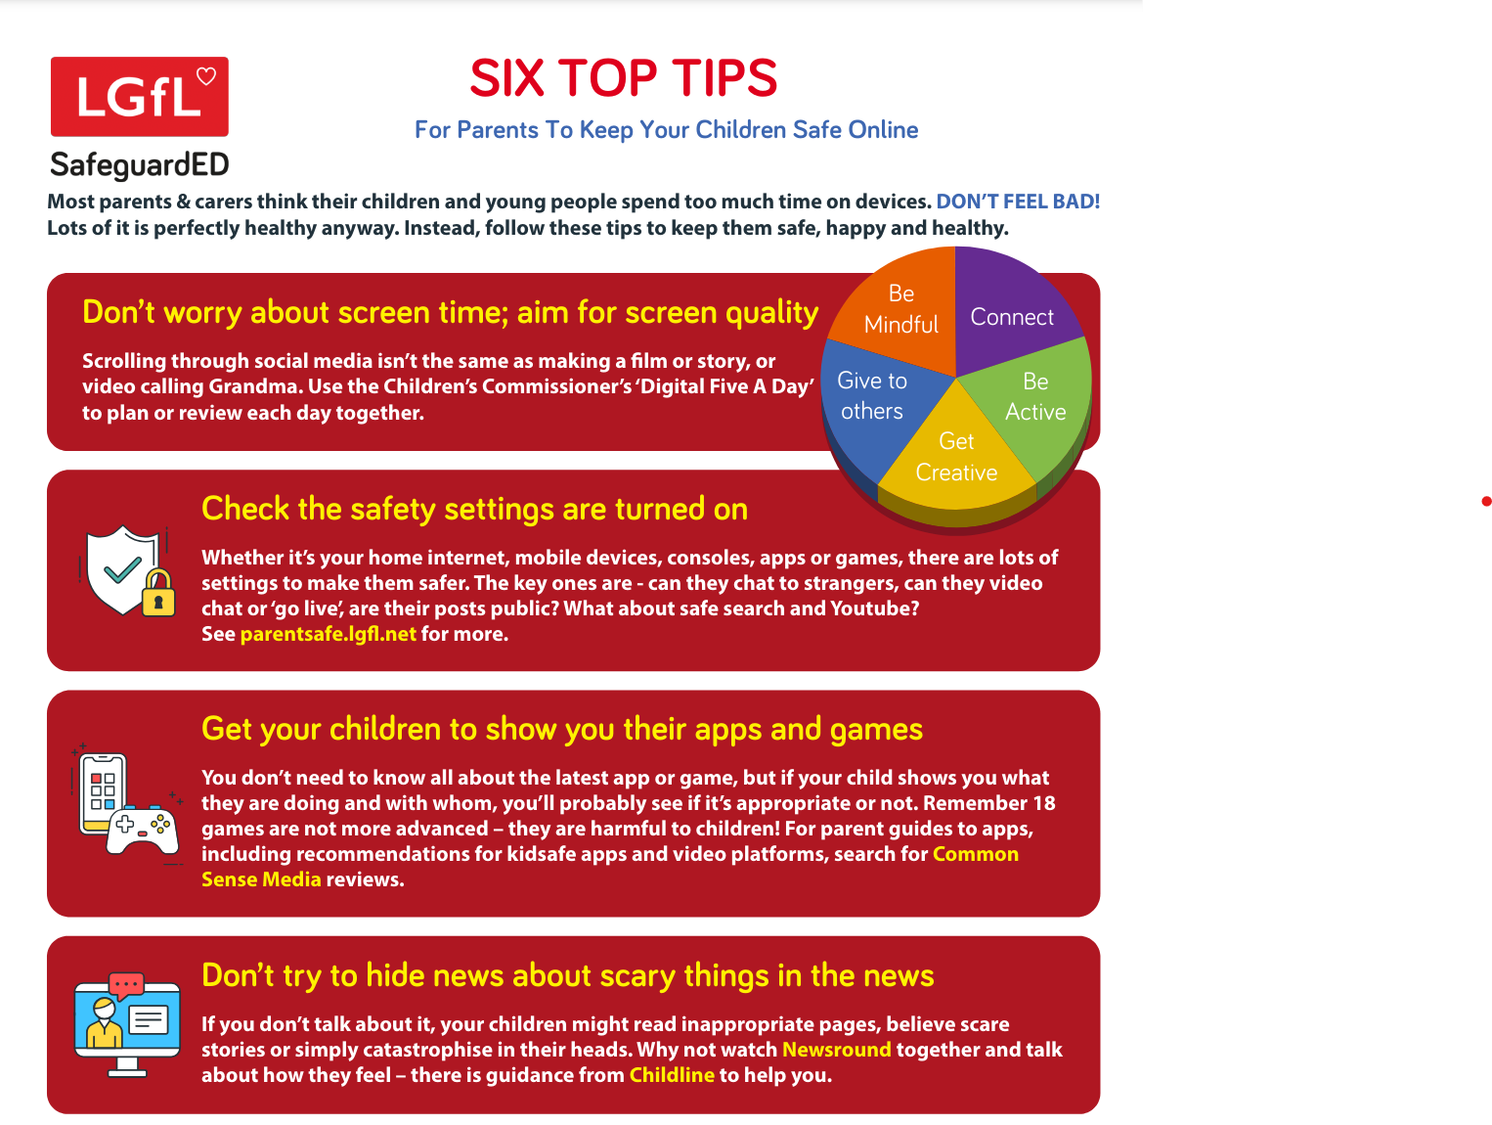
Notes:
TELL - why not put this fridge-friendly poster on your fridge?

Slide 60
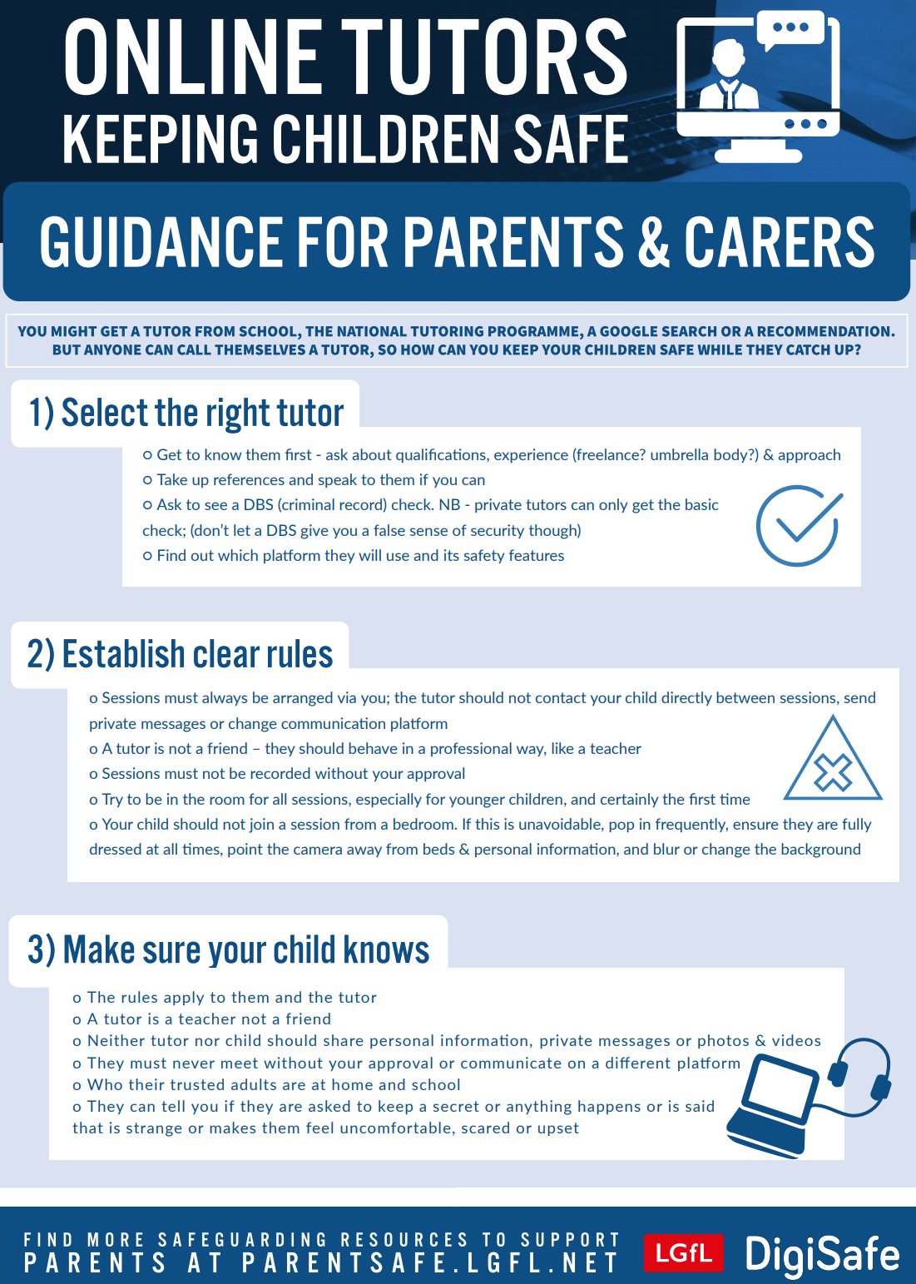
parentsafe.lgfl.net
Notes:
TELL - If you have an online tutor for your child, we have some useful tips and areas for consideration in this poster.

Slide 61

Why not have a family agreement to:
clarify what is allowed...or not
establish ground rules like no phones at the table or in the bedroom at night-time
agree shared expectations to reduce arguments and keep everyone safe & healthy
Download it at parentsafe.lgfl.net/digital-family-agreement
Notes:
TELL - LGfL have a free template of a digital family agreement that parents could sit down and populate with all family members to agree what is and is not allowed within their family around tech use. This includes parents! We need to role model good behaviour.
ASK – Can you think of any examples of how we as parents can model good behaviour?

Slide 62
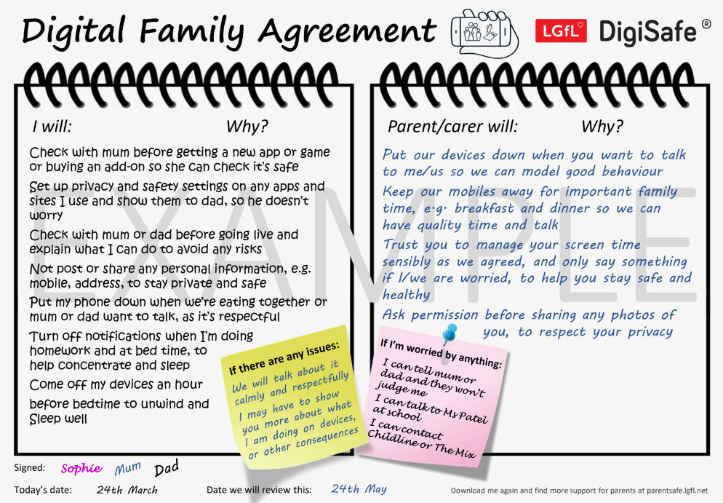
parentsafe.lgfl.net
Notes:
TELL - This is an example of a completed agreement to help you get started
Go through some of the example statements and discuss ideas for parents to be good role models, e.g. no devices at the dinner table, asking permission before sharing their child’s images (this is SHARENTING - see slide 23 for more information about sharenting)

Slide 63
Where to get help?
Safeguarding | Kensworth CE Academy
St Leonard's CE Academy - Safeguarding
Free online safety virtual workshop | NSPCC
Resources | Childnet
4–11 year olds | Childnet
Notes:
Please amend this slide with anything further you want to tell parents about reporting concerns to the school and seeking help

