Slide 1
Kensworth CE Academy

Slide 2
Reminder…

Slide 3
Sound Pronunciation
It is important that we use pure sounds, such as ‘s’ not ‘suh’, so that your child will be able to blend the sounds into words
https://youtu.be/yln6PpV1G1I

Slide 4
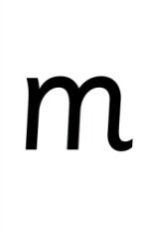
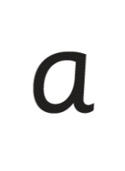








Systematic Approach
sat
p
mat
d
sad
i
t
n

Slide 5
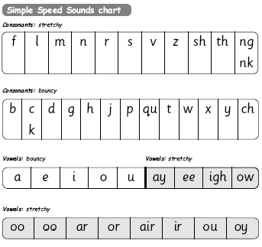
Simple Speed Sounds

Slide 6
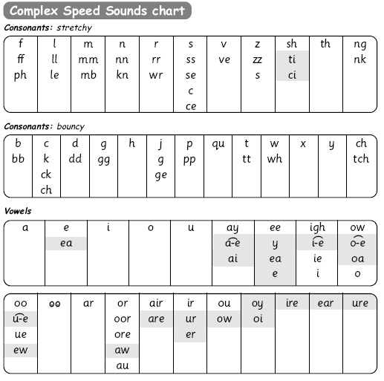
Speed Sounds Chart
Notes:
We use this Speed Sounds chart in Phonics lessons.
It shows the most common graphemes for each sound.
Each box is a sound box showing different ways to read and write the sound. Demo the ‘f’ sound box with examples of words ‘fun’, ‘huff’, ‘photo’ and the ‘or’ sound box with examples of words ‘or’, ‘door’, ‘more’, ‘dawn’, ‘author’.

Slide 7
Set 1

Slide 8
Set 2

Slide 9
Set 3

Slide 10
Blending Using Fred Talk, Including Fred Talk Games
p
d
sat
i
t
mat
sad
n

Slide 11

Fred Talk

Slide 12




Storybooks

Slide 13

What should my child read at home?

Slide 14



Picture Books And Anything That Interests Them!

Slide 15
How does Read Write Inc. teach spelling?

Slide 16

Fred Fingers

Slide 17
How can I help at home?

Slide 18
Storytime
Read to your children
Ask lots of questions and share opinions
Use a RWI support pack
You're never too old, too wacky, too wild, to pick up a book and read to a child.
Dr Seuss

Slide 19
Support How Your Child Is Learning To Read And Spell In School
Pure sounds
Fred Talk
Fred Fingers
Lots of talking!

Slide 20
Online resources available
Ruth Miskin Parents’ Page:
https://www.ruthmiskin.com/en/find-out-more/parents/
https://home.oxfordowl.co.uk/reading/reading-schemes-oxford-levels/read-write-inc-phonics-guide/
Free e-books for home reading:
https://home.oxfordowl.co.uk/reading/

Slide 21
For Maths:
Maths with Michael | Michael Underwood | White Rose Education
Maths home learning | Home learning | White Rose Education

